Slide 1

Machine Learning AIML CZG565 M5 : Decision Tree Classifier
BITS Pilani

Slide 2
Information Theory
Information theory :
a mathematical framework for quantifying the transmission, storage, and processing of information
Information(in this context) :
is a measure of the uncertainty associated with a random event. The more uncertain or unpredictable an event is, the more information is gained when that event occurs.

Slide 3
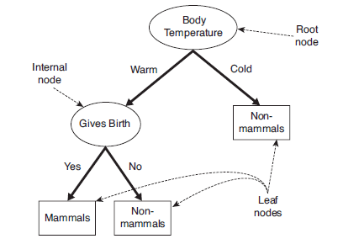
Decision Tree Representation
Flowchart-like tree structure.
The topmost node in a tree is the root node.
Each internal node denotes a test on an attribute.
Each branch represents an outcome of the test.
Each leaf node holds a class label.
Given a tuple for which the associated class label is unknown, the attribute values of the tuple are tested against the decision tree.
A path is traced from the root to a leaf node, which holds the class prediction for that tuple.

Slide 4
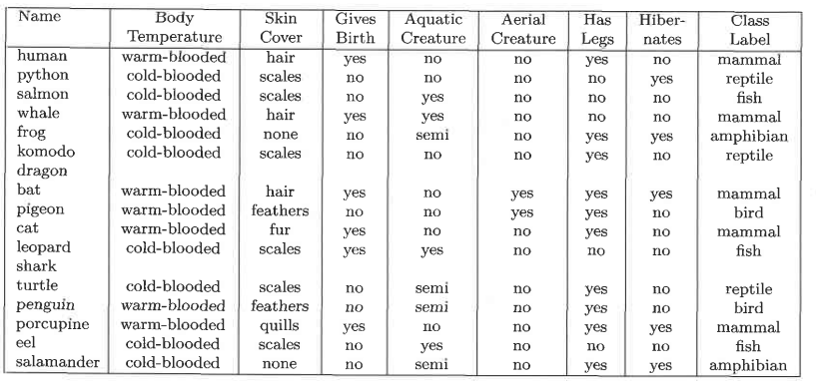
Decision Tree –Vertebrate Data Set

Slide 5
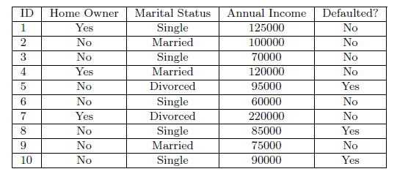
Decision tree example
Loan borrower classification problem

Slide 6
Decision Tree Example
Loan Borrower Classification Problem
Start from the root of tree.
Test Data
Home Owner
Yes
No
NO
MarSt
Single, Divorced
Married
Income
NO
< 80K
> 80K
NO
YES

Slide 7
Decision Tree Example
Loan Borrower Classification Problem
Test Data
Home Owner
Yes
No
NO
MarSt
Single, Divorced
Married
Income
NO
< 80K
> 80K
NO
YES

Slide 8
Decision Tree Example
Loan Borrower Classification Problem
Test Data
Home Owner
Yes
No
NO
MarSt
Single, Divorced
Married
Income
NO
< 80K
> 80K
NO
YES

Slide 9
Decision Tree Example
Loan Borrower Classification Problem
Test Data
Home Owner
Yes
No
NO
MarSt
Single, Divorced
Married
Income
NO
< 80K
> 80K
NO
YES

Slide 10
Decision Tree Example
Loan Borrower Classification Problem
Test Data
Home Owner
Yes
No
NO
MarSt
Single, Divorced
Married
Income
NO
< 80K
> 80K
NO
YES

Slide 11
Decision Tree Example
Loan Borrower Classification Problem
Test Data
Home Owner
Yes
No
NO
MarSt
Single, Divorced
Married
Assign Defaulted to “No”
Income
NO
< 80K
> 80K
NO
YES

Slide 12
Decision Tree Example
Loan Borrower Classification Problem
categorical
categorical
continuous
class
Splitting Attributes
Home Owner
Yes
No
NO
MarSt
Single, Divorced
Married
Income
NO
< 80K
> 80K
NO
YES
Training Data
Model: Decision Tree

Slide 13
Decision Tree-more than one tree
categorical
categorical
continuous
Single, Divorced
class
MarSt
Married
NO
Home Owner
Yes
No
NO
Income
< 80K
> 80K
NO
YES
There could be more than one tree that fits the same data!

Slide 14
HOW TO BUILD A DECISION TREE ?

Slide 15
How to Build a Decision Tree
Many Algorithms:
Hunt’s Algorithm (one of the earliest)
CART
ID3, C4.5
SLIQ,SPRINT

Slide 16
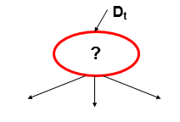
General Structure of Hunt’s Algorithm
Let D_{t} be the set of training records that are associated with a node t
General Procedure:
If D_{t} contains records that belong the same class y_{t},
then t is a leaf node labeled as y_{t}
If Dt contains records that belong to more than one class,
use an attribute test to split the data into smaller subsets.
Recursively apply the procedure to each subset.

Slide 17
Decision Tree Construction-HUNT’s Alg

Slide 18
Decision Tree-HUNT’S Algorithm
Construct a tree T from a training set D.
If all the records in D belong to class C or if D is sufficiently pure, then the node is a leaf node and assigned class label C.
Purity of a node is defined as the probability of corresponding class.
If an attribute A does not partition D in a sufficiently pure manner, then choose another attribute A^{j} and partition D according to A^{j} values.
Recursively construct tree and sub-trees until
All leaf nodes satisfy the minimum purity threshold.
Tree cannot be further split.
Maximum depth of tree is achieved.

Slide 19
Design Issues of Decision Tree Induction
Splitting Criterion
Method for specifying test condition
Depends on attribute types-Binary, Nominal, Ordinal, Continuous
Measure for evaluating the goodness of a test condition
Stopping Criterion
Stop splitting if all the records belong to the same class or have identical attribute values
Early termination

Slide 20
Test Condition for Nominal Attributes
Multi-way split:
Use as many partitions as distinct values.
Binary split:
Divides values into two subsets
Preserve order property among attribute values
This grouping violates order property

Slide 21
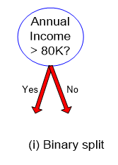
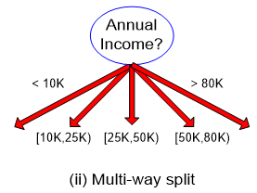
Test Condition for Continuous Attributes
Binary Decision :
consider all possible splits and finds the best cut
can be more compute intensive
Discretization :
to form an ordinal categorical attribute

Slide 22
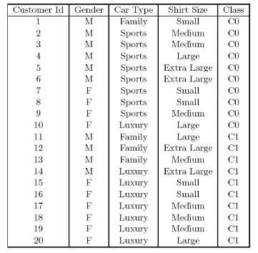
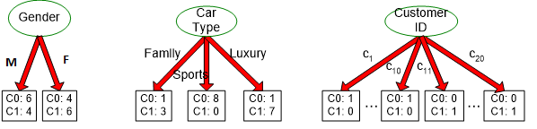
How to determine the Best Split
Before Splitting:
10 records of class 0 10 records of class 1
Which test condition is the best?

Slide 23
How to determine the Best Split
Impurity is a measure of homogeneity of the labels at the node at hand
Greedy approach:
Nodes with purer class distribution are preferred
Need a measure of node impurity:
High degree of impurity/ Relating it to information theory:
Low information content
e.g It rained heavily in Shillong yesterday
Low degree of impurity /
Relating it to information theory:
High information content
e.g There was a heavy rainfall in Rajasthan last night.

Slide 24
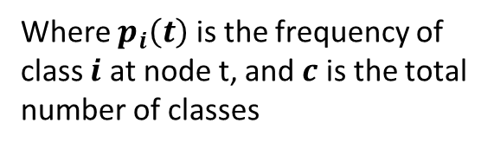
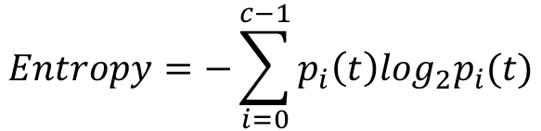
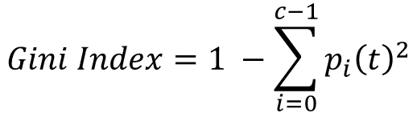
Selecting an Attribute Test Condition: Impurity Measure for a Single Node
$$Gini Index=1 −\sum_{i=0}^{c−1}{p_{i}{\left(t\right)}^{2}}$$
Where $p_{i}\left(t\right)$ is the frequency of class $i$ at node t, and $c$ is the total number of classes
$$Entropy=−\sum_{i=0}^{c−1}{p_{i}\left(t\right)log_{2}p_{i}(t)}$$
Measures seek to determine which variable would split the data to lead to the underlying child nodes being most homogenous or pure.
In other words splitting on attribute should reduce impurity

Slide 26
Selecting an Attribute Test Condition: Impurity Measure for a Single Node
p(C₁) = 0/6 = 0 and p(C₂) = 6/6 = 1
Gini = 1 − (0)² − (1)² = 0
Entropy = −(0) log₂(0) − (1) log₂(1) = 0
Low entropy and GINI index preferred
:– low impurity
p(C₁) = 1/6 and p(C₂) = 5/6
Gini = 1 − (1/6)² − (5/6)² = 0.278
Entropy = −(1/6) log₂(1/6) − (5/6) log₂(5/6) = 0.650
p(C₁) = 3/6 p(C₂) = 3/6
Gini = 1 − (3/6)² − (3/6)² = 0.5
Entropy = −(3/6) log₂(3/6) − (3/6) log₂(3/6) = 1

Slide 27
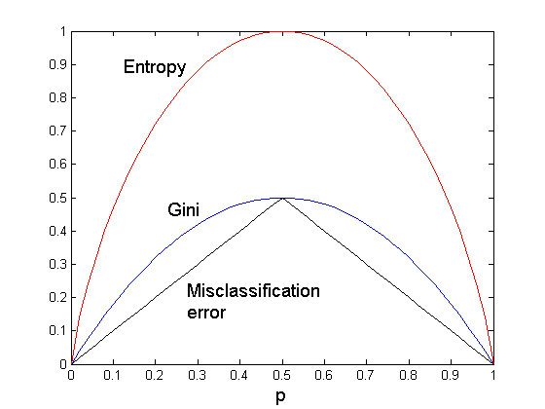
Comparison among Splitting Criteria
For a 2-class problem:

Slide 28
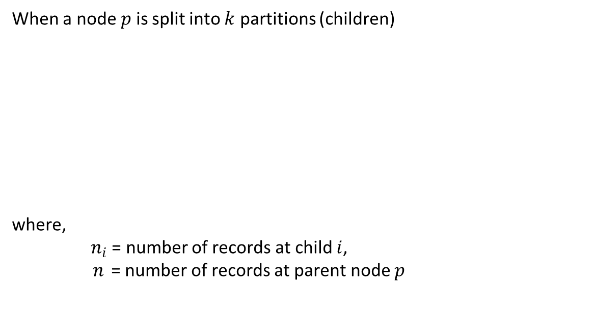
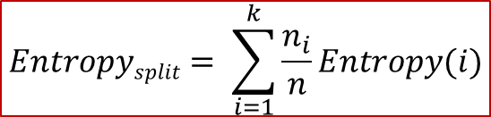

Selecting an Attribute Test Condition: Collective Impurity of Child Nodes
When a node $p$ is split into $k$ partitions (children)
where,
$n_{i}$ = number of records at child $i$,
$n$ = number of records at parent node $p$
$$GINI_{split}= \sum_{i=1}^{k}{\frac{n_{i}}{n}GINI(i)}$$
$$Entropysplit= \sum_{i=1}^{k}{\frac{n_{i}}{n}Entropy(i)}$$

Slide 29
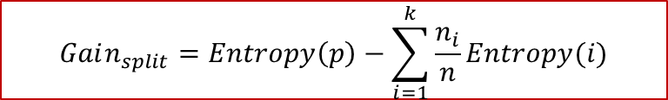
Selecting an Attribute Test Condition: Finding the Best Split
Compute impurity measure of the parent before splitting (P)
Compute the collective impurity measure of children after splitting(M)
Choose the attribute test condition that produces the highest gain Gain = P – M
or equivalently, lowest impurity measure after splitting (M)
Information gain is the expected reduction in entropy caused by partitioning the examples on an attribute.
Maximizing the gain == minimizing the weighted average impurity measure of children nodes
Choose the split that achieves most reduction (maximizes GAIN)
Used in the ID3 and C4.5 decision tree algorithms
$$Gain_{split}=Entropy\left(p\right)−\sum_{i=1}^{k}{\frac{n_{i}}{n}Entropy(i)}$$

Slide 30
DECISION TREE - ENTROPY
Numerical Example

Slide 31
Decision Tree - ENTROPY
Construct a decision tree for the given dataset using Information gain.
Outlook | Temp | Humidity | Windy | Play Golf
Rainy | Hot | High | False | No
Rainy | Hot | High | True | No
Overcast | Hot | High | False | Yes
Sunny | Mild | High | False | Yes
Sunny | Cool | Normal | False | Yes
Sunny | Cool | Normal | True | No
Overcast | Cool | Normal | True | Yes
Rainy | Mild | High | False | No
Rainy | Cool | Normal | False | Yes
Sunny | Mild | Normal | False | Yes
Rainy | Mild | Normal | True | Yes
Overcast | Mild | High | True | Yes
Overcast | Hot | Normal | False | Yes
Sunny | Mild | High | True | No

Slide 32
Decision Tree - ENTROPY
Set of possible instances X
each instance x in X is a feature vector
e.g., <Outlook=Rainy, Temp=Hot, Humidity=High, Windy=True>
Unknown target function f : X -> Y
Y is discrete valued
Set of function hypotheses H={ h | h : X->Y }
each hypothesis h is a decision tree
Trees sorts x to leaf, which assigns y
Construct a DT -> Find the attribute that returns the highest information gain
.

Slide 33
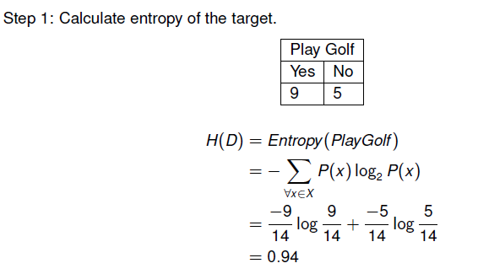
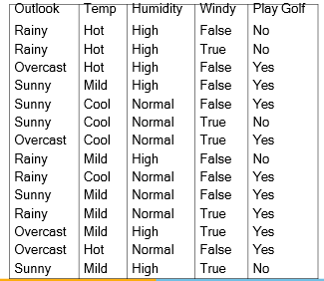
Decision Tree - ENTROPY

Slide 34
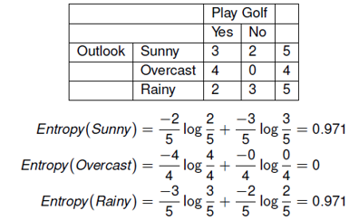
Decision Tree - ENTROPY

Slide 35
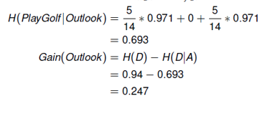
Decision Tree - ENTROPY

Slide 36
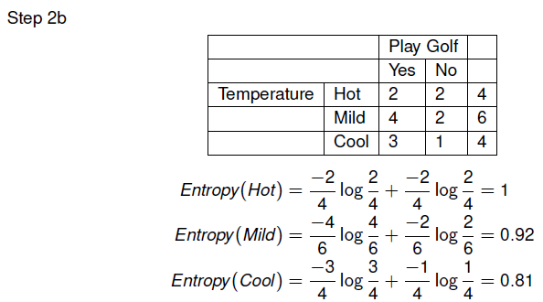
Decision Tree - ENTROPY

Slide 37
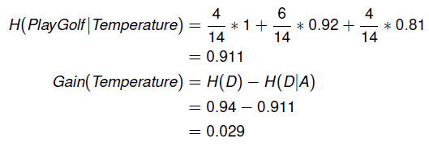
Decision Tree - ENTROPY

Slide 38
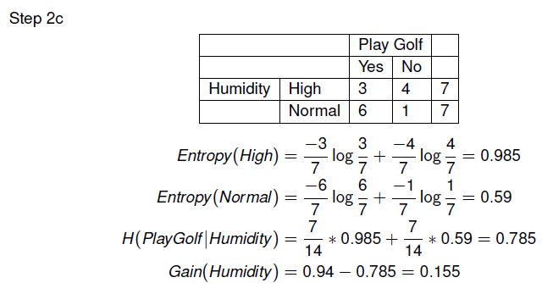
Decision Tree - ENTROPY

Slide 39
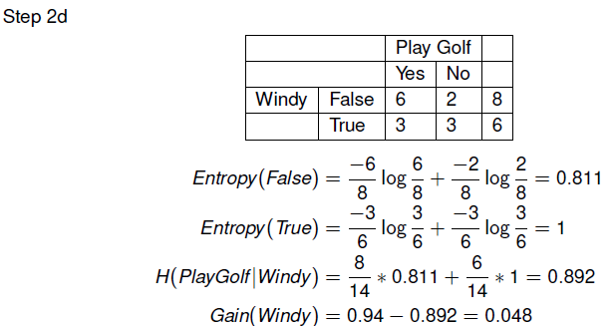
Decision Tree - ENTROPY

Slide 40
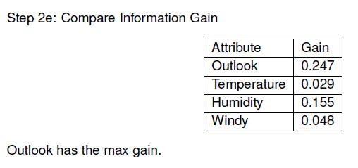
Decision Tree - ENTROPY

Slide 41
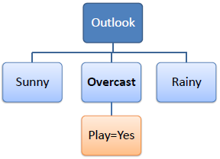
Decision Tree - ENTROPY
Step 3:
Choose attribute with the largest information gain as the decision node, divide the dataset by its branches and repeat the same process on every branch.
Outlook has the max gain. So choose Outlook as the root decision point.
A branch with entropy of 0 is a leaf node.
A branch with entropy more than 0 needs further splitting.

Slide 42
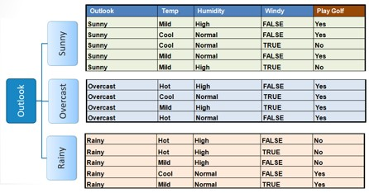
Decision Tree - ENTROPY
Step 4: Repeat

Slide 43
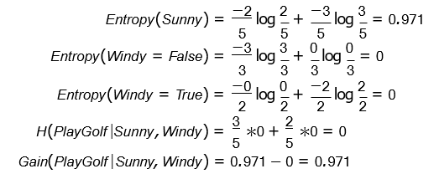
Decision Tree - ENTROPY
Step 4a: Consider only rows which have Outlook = Sunny.
Windy has max the max gain. Choose Windy as the next decision point.

Slide 44
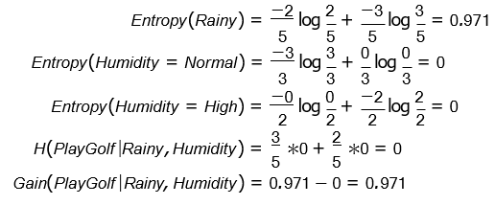
Decision Tree - ENTROPY
Step 4b: Consider only rows which have Outlook = Rainy.
Humidity has the max gain. Choose Humidity as the next decision point.

Slide 45
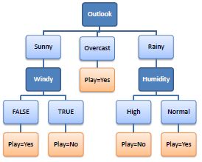
Decision Tree - ENTROPY
Step 5: Draw the final decision tree.

Slide 46
Construct a decision tree for the given dataset using Gini Index.
Decision Tree - Gini Index
Outlook | Temp | Humidity | Windy | Play Golf
Rainy | Hot | High | False | No
Rainy | Hot | High | True | No
Overcast | Hot | High | False | Yes
Sunny | Mild | High | False | Yes
Sunny | Cool | Normal | False | Yes
Sunny | Cool | Normal | True | No
Overcast | Cool | Normal | True | Yes
Rainy | Mild | High | False | No
Rainy | Cool | Normal | False | Yes
Sunny | Mild | Normal | False | Yes
Rainy | Mild | Normal | True | Yes
Overcast | Mild | High | True | Yes
Overcast | Hot | Normal | False | Yes
Sunny | Mild | High | True | No
Introduction to Data Science

Slide 47
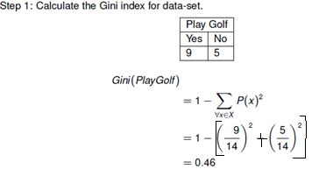
Decision Tree - Gini Index
Introduction to Data Science

Slide 48
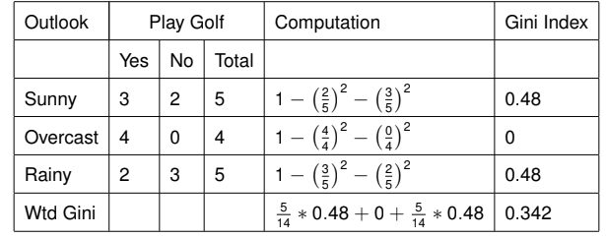
Decision Tree - Gini Index
Calculate the gini index of each attribute
Introduction to Data Science

Slide 49
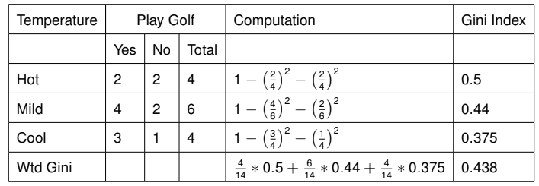
Decision Tree - Gini Index
Introduction to Data Science

Slide 50
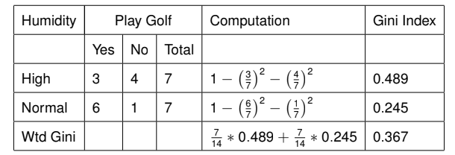
Decision Tree - Gini Index
Introduction to Data Science

Slide 51
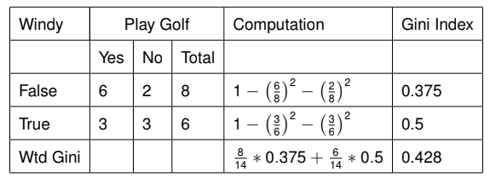
Decision Tree - Gini Index
Introduction to Data Science

Slide 52
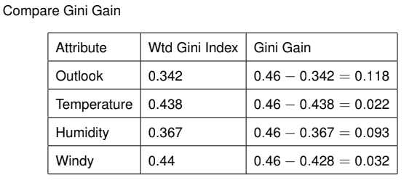
Decision Tree - Gini Index
Introduction to Data Science

Slide 53
Decision Tree - Gini Index
Step 3:
Choose attribute with the largest Gini gain as the decision node, divide the dataset by its branches and repeat the same process on every branch.
Outlook has the max Gini gain. So choose Outlook as the root decision point. A branch with Gini index of 0 is a leaf node.
A branch with Gini index more than 0 needs further splitting.
Introduction to Data Science

Slide 54
Decision Tree - Gini Index
Step 4: Repeat
Introduction to Data Science

Slide 55
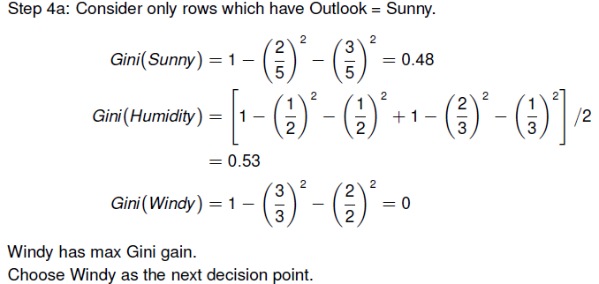
Decision Tree - Gini Index
Introduction to Data Science

Slide 56
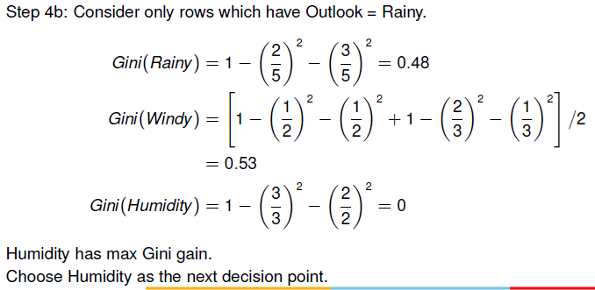
Decision Tree - Gini Index
Introduction to Data Science

Slide 57
Decision Tree - Gini Index
Step 5: Draw the final decision tree.
Introduction to Data Science

Slide 58
DECISION TREE - Practical Consideration

Slide 59
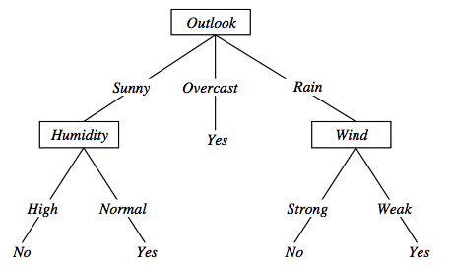
Decision Tree
Decision trees represent a disjunction of conjunctions on constraints on the value of attributes:
(Outlook = Sunny ∧ Humidity = Normal) ∨
(Outlook = Overcast) ∨
(Outlook = Rain ∧ Wind = Weak)
〈Outlook=Sunny, Temp=Hot, Humidity=High, Wind=Strong〉➔ No

Slide 60
Decision Tree-Problem with large number of partitions
Node impurity measures tend to prefer splits that result in large number of partitions, each being small but pure

Slide 61
Decision Tree-Problem with large number of partitions
Customer ID has highest information gain because entropy for all the children is zero
Very good on the training, this tree would perform poorly in predicting unknown instances. OVERFITTING

Slide 62
Decision Tree-Problem with large number of partitions-Solution
Method 1 :Restrict the test conditions to binary splits only-Used in CART
Method 2 :Modify the splitting criterion to take into account the number of outcomes produced by the attribute test condition-gain ratio

Slide 63
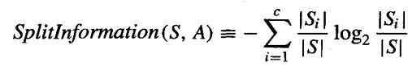
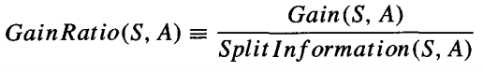
Decision Tree-GAIN RATIO
SplitInformation measures the entropy of S with respect to the values of A. The more uniformly dispersed the data the higher it is.
S1 through Sc, are the c subsets of examples resulting from partitioning S by the c-valued attribute A
The Gain Ratio measure is defined in terms of the Gain measure, as well as Splitlnformation

Slide 64
Decision Tree-GAIN RATIO
Let |S |=n, Customer ID splits examples in n classes
SplitInformation(S, Customer ID) = −[(1/n log₂ 1/n)+…+ (1/n log₂ 1/n)]
= −log₂1/n
= log₂n
Compare with A(Some other attribute), which splits data in two even classes:
SplitInformation(S, A) = − [(1/2 log₂1/2)+ (1/2 log₂1/2) ]
= − [− 1/2 −1/2]=1
A high value of Gain ratio is preferred.

Slide 65
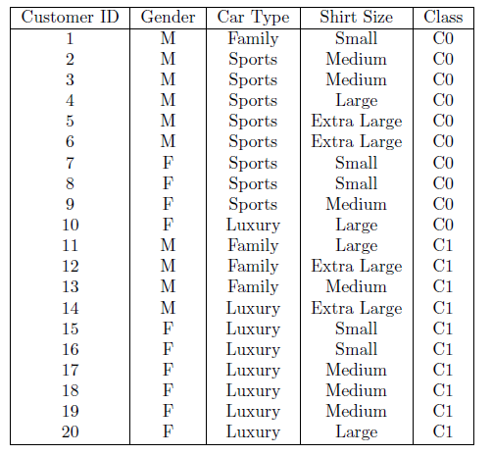
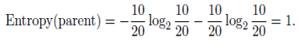
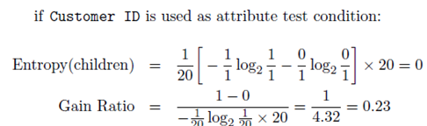
Decision Tree-GAIN RATIO
Inference : Even though Customer ID has the highest information gain, its gain ratio is lower than Car Type since it produces a larger number of splits

Slide 66
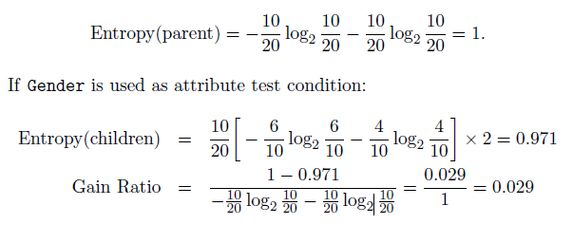
Decision Tree-GAIN RATIO

Slide 67
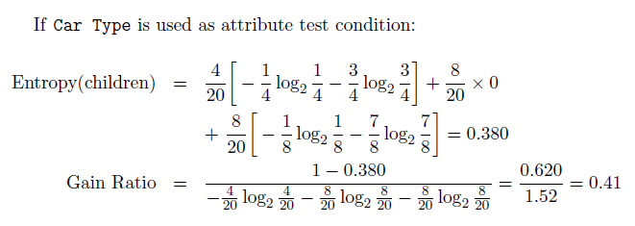
Decision Tree-GAIN RATIO

Slide 68
Dealing with continuous-valued attributes
If features are continuous, internal nodes can test the value of a feature against a threshold

Slide 69
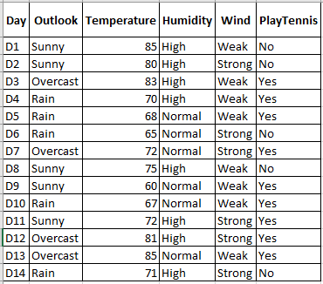
Dealing with continuous-valued attributes
Given a continuous-valued attribute A, dynamically define new discrete valued attribute Ac that partition the continuous attribute value into a discrete set of intervals
Ac = True if A < c, False otherwise
How to select the best value for the threshold c?

Slide 70
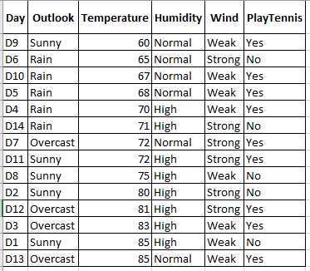
Dealing with continuous-valued attributes
How to select the best value for the threshold c?
Example. Temperature in the example
Sort the examples according to Temperature
Temperature
PlayTennis
Determine candidate thresholds by averaging consecutive values where there is a change in classification:

Slide 71
Dealing with continuous-valued attributes
How to select the best value for the threshold c?
The candidate thresholds identified are:
62.5 ,66,70.5,71.5,73.5,80.5,84
Evaluate Candidate Thresholds
Threshold = 62.5
Group 1 (Temperature ≤ 62.5): [60, Yes]
Group 2 (Temperature > 62.5): [65, No; 67, Yes; 68, Yes; 70, Yes; 71, No; 72, Yes; 75, No; 80, No; 81, Yes; 83, Yes; 85, No]
Calculate Entropy for Group 1 and Group 2 and their weighted Entropy, then find the information gain.
Calculate Information gain
We will calculate the Information gain for each of these candidate thresholds.
Pick the one with the maximum gain.

Slide 72
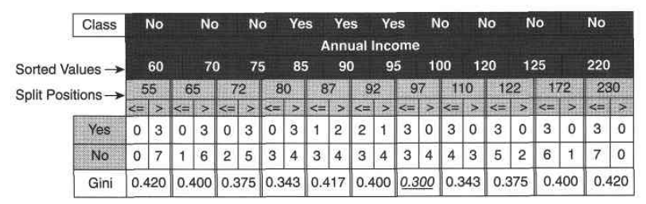
Dealing with continuous-valued attributes

Slide 73
Decision Tree-ID3
Uses Hunt’s algorithm
Uses information gain as the measure to select the best attribute at each step in the growing tree
Does not have the ability to determine how many alternative decision trees are consistent with the available training data
Shorter trees are preferred over longer trees.
Trees that place high information gain attributes close to the root are preferred over those that do not - Inductive bias of ID3
Refer: Mitchell

Slide 74
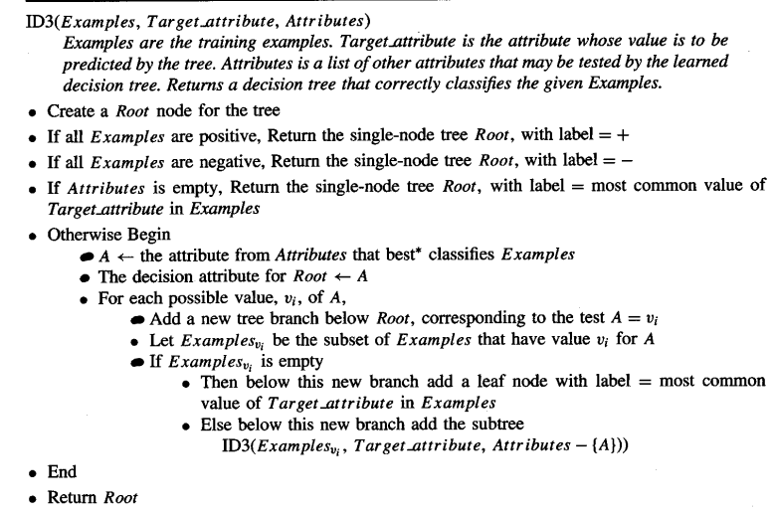
Decision Tree-ID3

Slide 75
Convergence of Algorithm
•Conditions for stopping partitioning
•All samples for a given node belong to the same class
There are no remaining attributes for further partitioning – majority voting is employed for classifying the leaf
There are no samples left

Slide 76
Decision Trees – Practise
Sky | AirTemp | Humidity | Wind | Forecast | EnjoySport?
Sunny | Warm | Normal | Strong | Same | Yes
Sunny | Warm | High | Strong | Same | Yes
Rainy | Cold | High | Strong | Change | No
Sunny | Warm | High | Strong | Change | Yes
Rainy | Warm | Normal | Breeze | Same | ????
Predict the class for new input instance 🡪
Sky
Sunny
Rainy
YES
NO

Slide 77
Problem – Evaluate the model Confusion Matrix
Actual class\Predicted class | C₁ | ¬ C₁
C₁ | True Positives (TP) | False Negatives (FN)
¬ C₁ | False Positives (FP) | True Negatives (TN)
The evaluation discussed under module 4 is applicable here
By default , model’s predictive quality is evaluated only by the unseen validation/test instances.
When training performance (eg., accuracy) is required for comparison, the training instances are used for assessment
CM_{i,j} indicates the number of tuples of class i that were labelled by the classifier as class j.
Sky | AirTemp | Humidity | Wind | Forecast | EnjoySport?
Sunny | Warm | Normal | Strong | Same | Yes
Sunny | Warm | High | Strong | Same | Yes
Rainy | Cold | High | Strong | Change | No
Sunny | Warm | High | Strong | Change | Yes
Rainy | Warm | Normal | Breeze | Same | Yes
Sky
Sunny
Rainy
YES
NO

Slide 78
Applications
Suited for following classification problems:
Applications whose Instances are represented by attribute-value pairs.
The target function has discrete output values
Disjunctive descriptions may be required
The training data may contain missing attribute values
Real world applications
Biomedical applications
Manufacturing
Banking sector
Make-Buy decisions

Slide 79
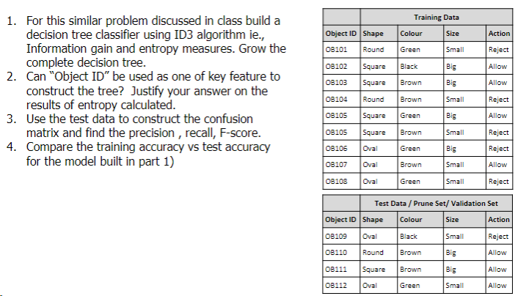
Practice Exercises (for Students)

Slide 80
DECISION TREE - Occam’s Razor and Overfitting

Slide 81
Decision Tree:Why prefer shorter hypotheses? Occam's razor
The hypothesis may be represented as follows:
If Outlook is "Sunny" and Humidity is "High" then PlayTennis = "No".
If Outlook is "Overcast" then PlayTennis = "Yes".
If Outlook is "Rain" and Wind is "Weak" then PlayTennis = "Yes".
Occam's razor: Prefer the simplest hypothesis that fits the data.
{When presented with competing hypotheses that make the same predictions, one should select the solution which is simple}
Arguments in favor:
There are fewer short hypotheses than long ones
If a short hypothesis fits data unlikely to be a coincidence
Elegance and aesthetics
Arguments against:
Not every short hypothesis is a reasonable one.

Slide 82
Decision Tree:Overfitting
Training errors (apparent errors)--Errors committed on the training set
Test errors -- Errors committed on the test set
Generalization errors -- Expected error of a model over random selection of records from same distribution

Slide 83

Decision Tree:Overfitting
Two class problem:
+ : 5200 instances
5000 instances generated from a Gaussian centered at (10,10)
200 noisy instances added
o : 5200 instances
Generated from a uniform distribution

Slide 84

Decision Tree:Overfitting

Slide 85


Decision Tree with 4 nodes:Overfitting
Decision Tree
Decision boundaries on Training data
Decision boundaries on Training data

Slide 86


Decision Tree with 50 nodes:Overfitting
Decision Tree
Decision boundaries on Training data
Decision boundaries on Training data

Slide 87


Decision Tree :Overfitting
Which tree is better ?
Decision Tree with 4 nodes
Decision Tree with 50 nodes

Slide 88


Decision Tree :Overfitting
Underfitting: when model is too simple, both training and test errors are large
Overfitting: when model is too complex, training error is small but test error is large

Slide 89
Decision Tree :Handling Overfitting
Two approaches
Pre pruning (early stopping rule)
Stop growing the tree earlier, before it reaches the point where it perfectly classifies the training data
Difficult to estimate when to stop growing the tree
Post-pruning
Allow the tree to overfit the data, and then post-prune the tree

Slide 90
Decision Tree :Handling Overfitting
Pre-Pruning (Early Stopping Rule)
Stop the algorithm before it becomes a fully-grown tree
Typical stopping conditions for a node:
Stop if all instances belong to the same class
Stop if all the attribute values are the same
More restrictive conditions:
Stop if number of instances is less than some user-specified threshold
Stop if expanding the current node does not improve impurity measures (e.g., Gini or information gain).
Stop if estimated generalization error falls below certain threshold

Slide 91
Pre-pruning
Train set
Predict if the object being manufactured is likely to be “Reject”ed or “Allow”ed to be packed during the automated product inspection
Based on object features like : Shape, colour, size
Assume this the trained model which is an over fit. Let try to experiment on Pre-pruning & Post-pruning technique.
Use validation set/test set for this experiments
Shape | Colour | Size | Action
Round | Green | Small | Reject
Square | Black | Big | Allow
Square | Brown | Big | Allow
Round | Brown | Small | Reject
Square | Green | Big | Allow
Square | Brown | Small | Reject
Oval | Green | Big | Reject
Oval | Brown | Small | Allow
Oval | Green | Small | Reject
Shape
Assumed over fit model
Round
Square
Oval
Test set
Size
Colour
Big
Small
Green
Shape | Colour | Size | Action
Oval | Black | Small | Reject
Round | Brown | Big | Allow
Square | Brown | Big | Allow
Oval | Green | Small | Allow
Brown
Allow
Reject
Reject
Allow
Colour
Green
Brown
Size
Size
Small
Reject
Reject

Slide 92
Pre-Pruning
Prune if threshold Gain <=0.85
Shape | Colour | Size | Action
Round | Green | Small | Reject
Square | Black | Big | Allow
Square | Brown | Big | Allow
Round | Brown | Small | Reject
Square | Green | Big | Allow
Square | Brown | Small | Reject
Oval | Green | Big | Reject
Oval | Brown | Small | Allow
Oval | Green | Small | Reject
Shape
Round
Square
Oval
Reject
Colour | Size | Action
Black | Big | Allow
Brown | Big | Allow
Green | Big | Allow
Brown | Small | Reject
Colour | Size | Action
Green | Big | Reject
Brown | Small | Allow
Green | Small | Reject
Gain =0.8113 Gain =0.9182
Shape | Colour | Size | Action
Oval | Black | Small | Reject
Round | Brown | Big | Allow
Square | Brown | Big | Allow
Oval | Green | Small | Allow
Use maximum gain to stop the tree growth as threshold for pre-pruning

Slide 93
Pre-Pruning
Prune if threshold Gain <=0.85
Shape | Colour | Size | Action
Round | Green | Small | Reject
Square | Black | Big | Allow
Square | Brown | Big | Allow
Round | Brown | Small | Reject
Square | Green | Big | Allow
Square | Brown | Small | Reject
Oval | Green | Big | Reject
Oval | Brown | Small | Allow
Oval | Green | Small | Reject
Shape
Round
Square
Oval
Reject
Colour | Size | Action
Black | Big | Allow
Brown | Big | Allow
Green | Big | Allow
Brown | Small | Reject
Colour
Green
Brown
Reject
Allow
Use majority voting to label the nodes post pruning
Shape | Colour | Size | Action
Oval | Black | Small | Reject
Round | Brown | Big | Allow
Square | Brown | Big | Allow
Oval | Green | Small | Allow

Slide 94
Pre-Pruning
Shape | Colour | Size | Action
Round | Green | Small | Reject
Square | Black | Big | Allow
Square | Brown | Big | Allow
Round | Brown | Small | Reject
Square | Green | Big | Allow
Square | Brown | Small | Reject
Oval | Green | Big | Reject
Oval | Brown | Small | Allow
Oval | Green | Small | Reject
Prune if threshold Gain <=0.85
Shape
Round
Square
Oval
Reject
Allow
Colour
Green
Brown
Reject
Allow
Shape | Colour | Size | Action
Oval | Black | Small | Reject
Round | Brown | Big | Allow
Square | Brown | Big | Allow
Oval | Green | Small | Allow

Slide 95
Decision Tree :Handling Overfitting
Post Pruning :Idea
Post construction, scan the tree bottom-up
At every decision node
Retain the attribute node & evaluate it against the prune set (validation set)
Remove the attribute node & reevaluate it with the same prune set
If there is a reduction in error, prune the node else retain the node
Repeat this in other branches of the tree

Slide 96
Post Pruning
Shape | Colour | Size | Action
Round | Green | Small | Reject
Square | Black | Big | Allow
Square | Brown | Big | Allow
Round | Brown | Small | Reject
Square | Green | Big | Allow
Square | Brown | Small | Reject
Oval | Green | Big | Reject
Oval | Brown | Small | Allow
Oval | Green | Small | Reject
Shape
Round
Square
Oval
Reject
Size
Colour
Big
Small
Green
Brown/others
Allow
Reject
Reject
Allow
Shape | Colour | Size | Action
Oval | Black | Small | Reject
Round | Brown | Big | Allow
Square | Brown | Big | Allow
Oval | Green | Small | Allow
Error rate is the percentage of tuples misclassified
Prune set is used to estimate the cost

Slide 97
Post Pruning
Shape | Colour | Size | Action
Round | Green | Small | Reject
Square | Black | Big | Allow
Square | Brown | Big | Allow
Round | Brown | Small | Reject
Square | Green | Big | Allow
Square | Brown | Small | Reject
Oval | Green | Big | Reject
Oval | Brown | Small | Allow
Oval | Green | Small | Reject
Shape
Round
Square
Oval
Reject
Size
Colour
Big
Small
Green
Brown/others
Allow
Reject
Reject
Allow
After test prune on “Size” and “Color” attributes, its observed that “Colour” is best pruned to get better accuracy!
Prune Size &Predict | Prune Colour & Predict | Above Tree’s Prediction | Shape | Colour | Size | Action
Allow | Reject | Allow | Oval | Black | Small | Reject
Reject | Reject | Reject | Round | Brown | Big | Allow
Allow | Allow | Allow | Square | Brown | Big | Allow
Reject | Reject | Reject | Oval | Green | Small | Allow

Slide 98
Revision for Mid Term Examination
Review of uploaded Question Paper
Important Note to students:
Check the canvas announcement for any exam related details/ question pattern/ sample questions.
Handout mapped prescribed book sections, class discussions , practice exercises shared in all the slides must be revised for the exam preparation
Since the mid term exam is CLOSED BOOK mode, no reference material is allowed and hence formula needs to be learnt by the students
Queries may not be answered once the exam starts.
Kindly Plan ahead to get your preparation queries resolved before the EXAM START DATE of your batch.

Slide 99
References
Thank You, Happy decision making :)
Chapter 3 - Machine Learning by Tom Mitchell (T1)
Chapter 4 - Introduction to Data Mining by Pang-Ning Tan, Michael Steinbach, Vipin Kumar (R2)
https://www.youtube.com/watch?v=eKD5gxPPeY0&list=PLBv09BD7ez_4temBw7vLA19p3tdQH6FYO&index=1

